Slide 1
Introduction to Data Center
Outline:
1.1 Introduction to Data Center?
1.1.1 What is Data Center
1.1.2 Design guideline of Data Center

Slide 2
1.1 What is a Data Center?
“A Building or portion of a building whose primary function is to house a computer room and its support area’s.
In other words, A data center (sometimes spelled datacenter) is a centralized repository, either physical or virtual, for the storage, management, and dissemination of data and information organized around a particular body of knowledge or pertaining to a particular business.

Slide 3
1.1 What’s in a Data Center?
Data Center
Servers ( Physical & Virtual)
Virtual Library System
Tape Backup System
EVA 4400 Storage & SAN Switch
Network Equipments
Temp. Monitoring System
Video Conferencing System
Telephone System
Security System
Microwave System
Satellite System

Slide 4
1.1.2 Design Issues of Data Center
1.1.2.1 Location
1.1.2.2 Physical Features
1.1.2.3 Cooling System
1.1.2.4 Electrical and UPS
1.1.2.5 Fire protection
1.1.2.6 Security System
1.1.2.7 Disaster recovery

Slide 5
1.1.2.1 Location
Access and proximity to cable pathways
Telecom provider requirements
Proximity to electrical service and
Electro-magnetic interference (EMI) sources
Space for present and for future expansion
HVAC (Heating Ventilation and Air Conditioning) issues
Adjacency to elevator(s)
Avoid Location with
Water Infiltration
High humidity from nearby sources
Heat (e.g., direct sunlight)
Potential for flooding

Slide 6
1.1.2.2 Physical Features
Square room is preferable
Measure physical sizes of all items - height in rack units (1 RU = 1.75 inches)
Account for HVAC equipment, power distribution, and UPS systems
High voltage electrical panels and transformers must be at least 36” from racks & equipment
A minimum ceiling height of 10’-0”
Door at least three feet (3') wide and should swing open out of the room (double doors preferable)
No tight turns to get into room
Interior walls should be painted with fire retardant paint
Ceiling should be painted white

Slide 7
1.1.2.3 Cooling System
Temperature 16°C - 22°C
Positive air flow
Hot and cold aisles
Humidity of 55 - 30%, noncondensing
Continuous cooling (24 hours x 365)
Cooling independent of building automatic shutdown system and not subject to building power-saving shutdowns

Slide 8
1.1.2.4 Electrical and UPS
To determine electrical and cooling load, add up power draw of all equipment/ systems known (including UPS systems in room) and multiply by 1.5 – 2 for growth
NOTE: Blade servers and high density rackmount servers have extra needs for electricity and cooling
Lighting, HVAC, and convenience receptacles should be fed from different branch circuits than the telecommunication equipment
Electrical Design
Provide sub-breakers per rack
Typical 60 watts/ sq. ft.
Establish a high-density area of 100-200 watts/sq. ft. for enclosures rated at 3-6 kW per enclosure
Continued..

Slide 9
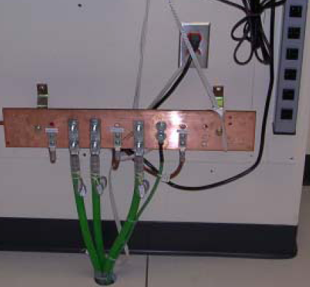
1.1.2.4 Electrical and UPS
Lighting
Coordinate positions of light fixtures with layout, particularly cable trays & cabinets
Emergency lighting consistent with emergency system for the building
Grounding System:

Slide 10
1.1.2.5 Fire protection
Non-water based preferred (FM-200)
If sprinklers required by code, place troughs above the most expensive equipment to shunt water
Install pre-action system (dry pipe)
Consult with Fire Protection Engineers for sprinkler placement and required clearances between sprinklers, conduit and/or cable trays
All penetrations must be sealed with smoke and flame stop materials

Slide 11
1.1.2.6 Security System
All doors should be controlled
Door access
– proximity card/badge or biometric
– No keyed locks or numbered keypads
– Door should alarm if left open
Interior room (no windows)
Walls up to deck (demising walls)

Slide 12
1.1.2.7 Disaster recovery
Disaster Recovery
Prevent and mitigate risks
Generator w/48 hours of fuel
UPS (see next slide) – test monthly
Redundant cooling
Alternate/backup data center site
– hot
– warm
– cold

Slide 13
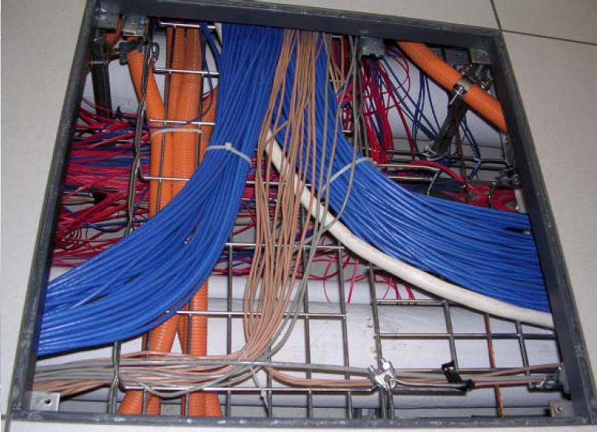
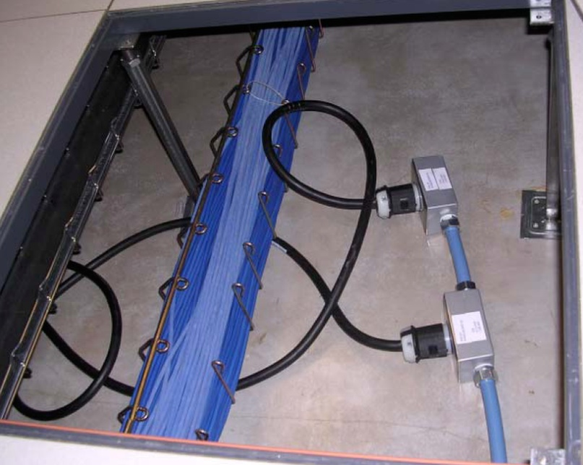
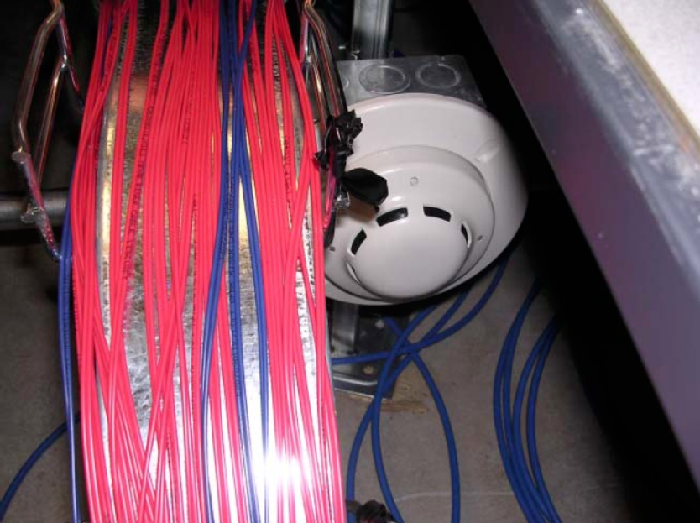
Don’ts

Slide 14
?

